Slide 1
WORDPRESS
Submitted By:
Paramjeet Kaur(C0710778)
Jaspreet Kaur (C0709466)

Slide 2
Overview
WordPress is an open source Content Management System (CMS), which allows the users to build dynamic websites and blog. WordPress is the most popular blogging system on the web and allows updating, customizing and managing the website from its back-end CMS and components.

Slide 3
What is Content Management System (CMS)?
The Content Management System (CMS) is a software which stores all the data such as text, photos, music, documents, etc. and is made available on your website. It helps in editing, publishing and modifying the content of the website.

Slide 4
Features
User Management
Media Management
Theme System
Extend with Plugins
Multilingual
Importers

Slide 5
Advantages
Open source .
CSS files can be modified .
Plugins and templates.
Media files can be uploaded easily and quickly.
SEO tools which makes on-site SEO simple.
Customization .
Different roles for users.

Slide 6
Disadvantages
Heavy to load and run.
PHP knowledge is required.
WordPress updation.
Graphic images and tables.

Slide 7
Wordpress Installation
Database − MySQL 5.0 +
Web Server −
WAMP (Windows)
LAMP (Linux)
XAMP (Multi-platform)
MAMP (Macintosh)
Operating System − Cross-platform
Browser Support − IE (Internet Explorer 8+), Firefox, Google chrome, Safari, Opera
PHP Compatibility − PHP 5.2+

Slide 8
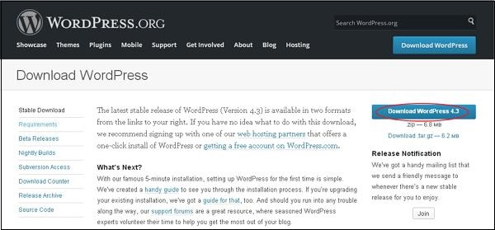
Download WordPress Click on this link https://wordpress.org/download/
WordPress requires MySQL database.

Slide 9
Set up wordpress
Step (1) − Extract the downloaded WordPress folder and upload it into your web server or localhost.
Step (2) − localhost/<wordpress_folder >.
Language selection.

Slide 10
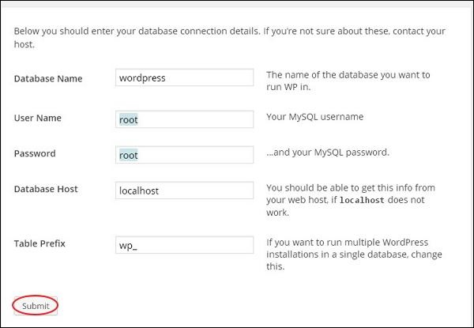
Step (3) −Database Information.

Slide 11
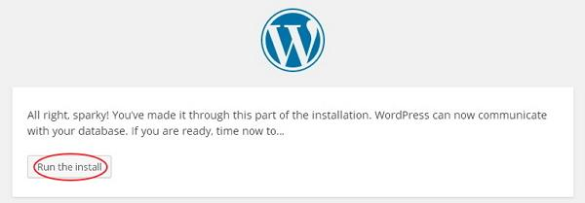
Step (4) − Confirmation screen.
Click on Run the install

Slide 12
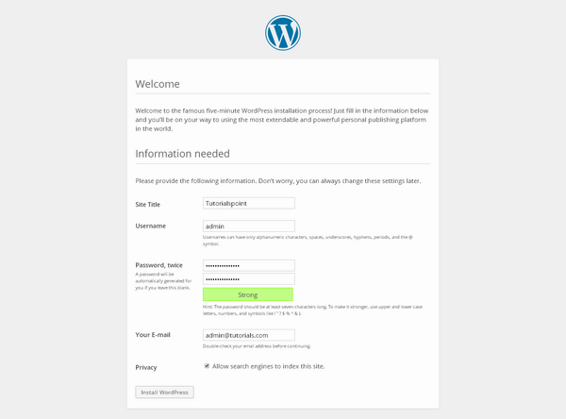
Step (5) − Enter administrative information.

Slide 13
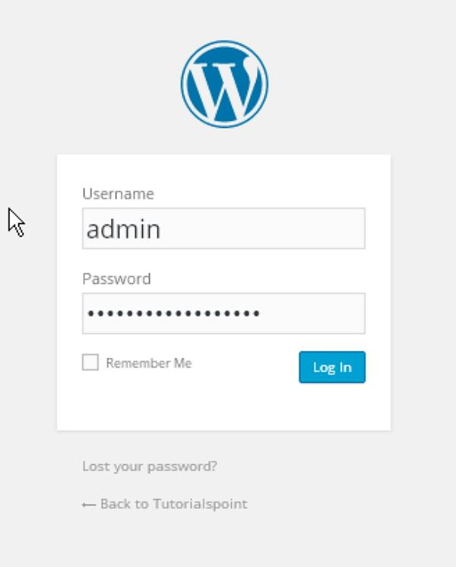
Step (6) − WordPress Admin Panel.

Slide 14
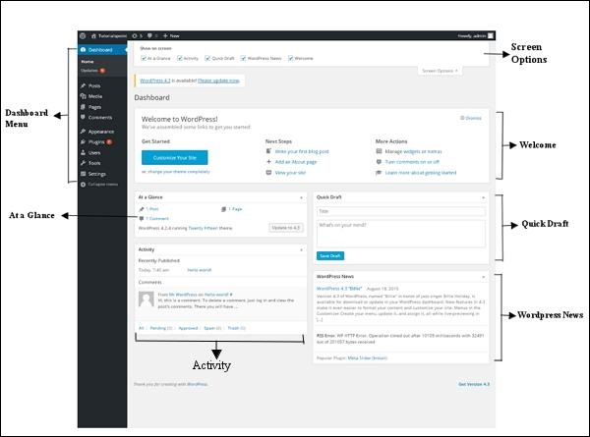
WordPress - Dashboard
The WordPress Dashboard is a first screen when you log into the administration area of your blog which will display the overview of the website.

Slide 15
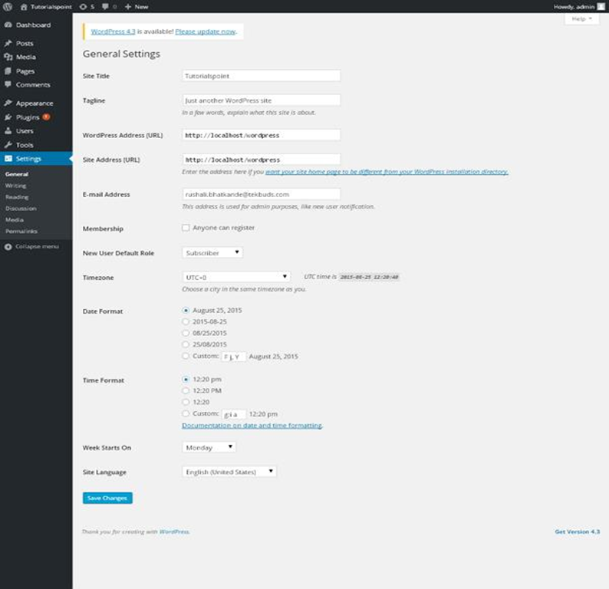
WordPress - General Setting

Slide 16
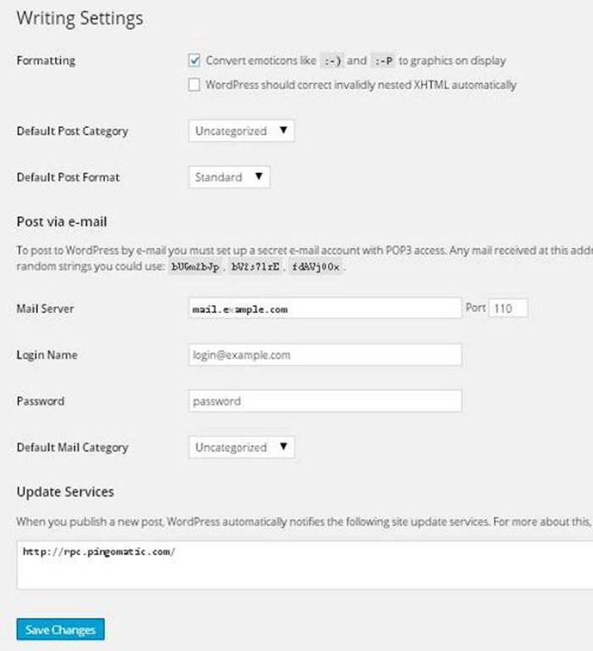
WordPress - Writing Setting

Slide 17
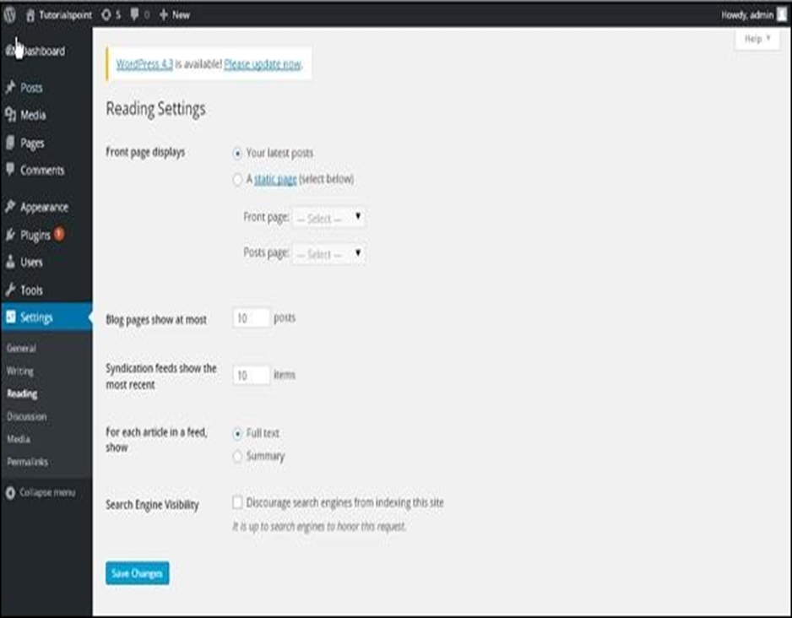
WordPress - Reading Setting

Slide 18
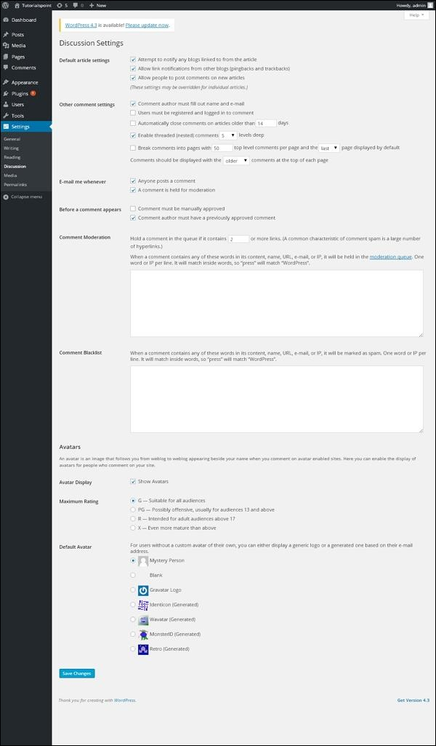
WordPress - Discussion Setting

Slide 19
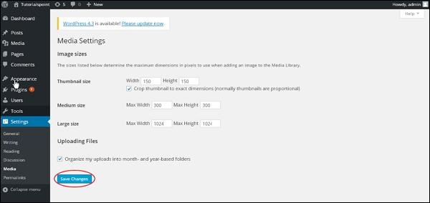
WordPress - Media Setting

Slide 20
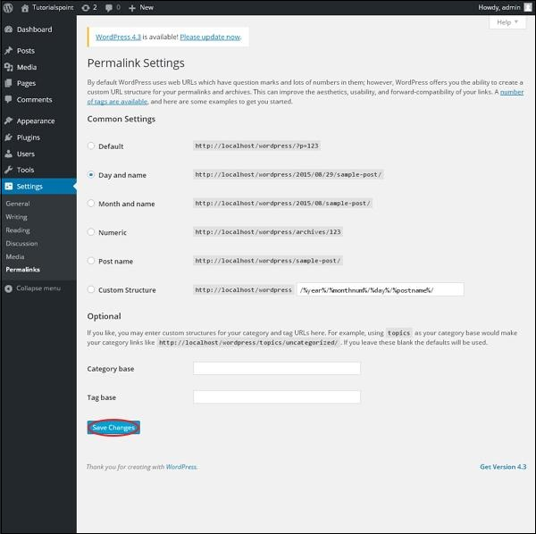
WordPress - Permalink Setting

Slide 21
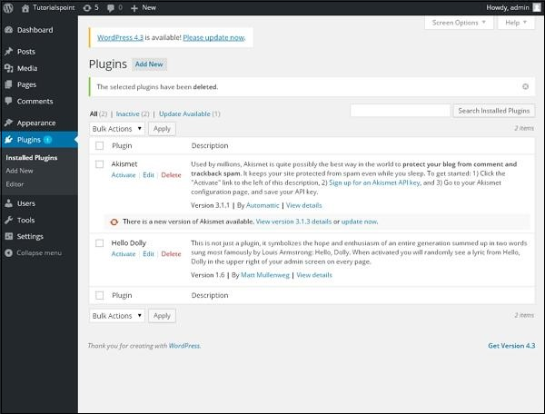
WordPress - Plugin Setting

Slide 22
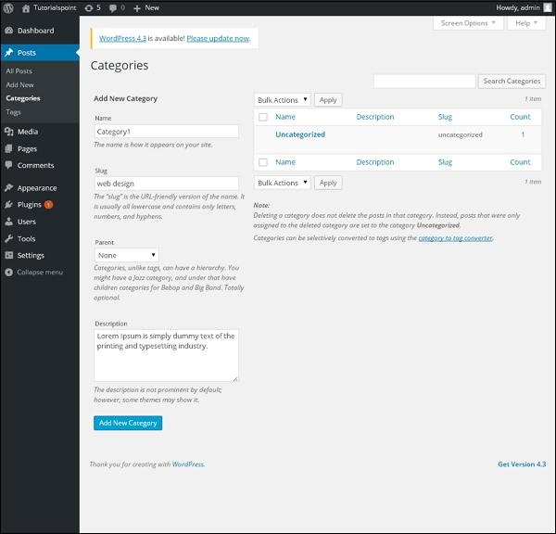
WordPress-Add Category Category is used to indicate sections of your site and group related posts. It sorts the group content into different sections. It is a very convenient way to organize the posts.

Slide 23
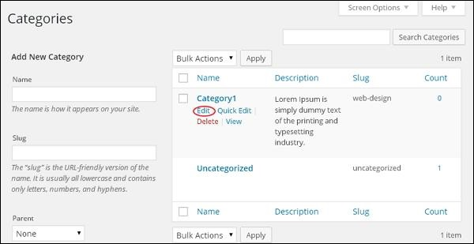
WordPress – Edit and Delete Category

Slide 24
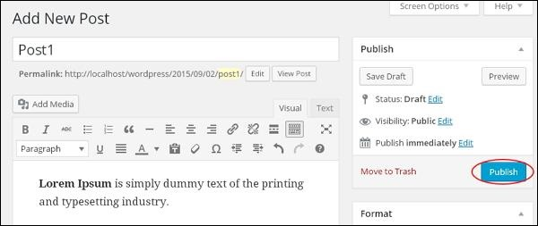
WordPress–Add,Edit,Delete,Preview and Publish Posts Posts are also known as articles and sometimes referred as blogs or blog posts. These are used to popularize your blogs.

Slide 25
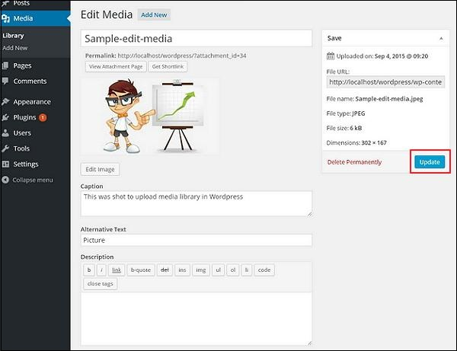
Wordpress-Add,Edit and Delete Media Media Library consists of the images, audios, videos and files that you can upload and add to the content when writing a Post or Page.

Slide 26
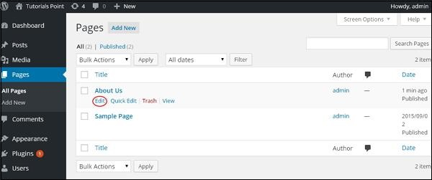
Wordpress-Add,Edit,Delete and view Pages Adding pages is similar to adding posts in WordPress. Pages are static content and often do not change its displayed information.

Slide 27
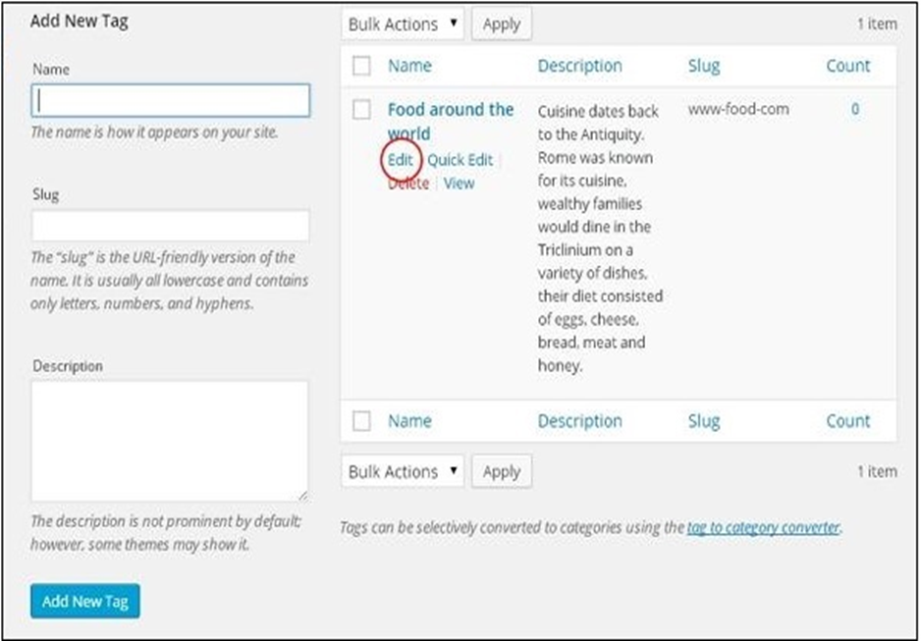
Wordpress -Add , Edit and Delete Tags Tag is a small information attached to the main content or post for the purpose of identification.

Slide 28
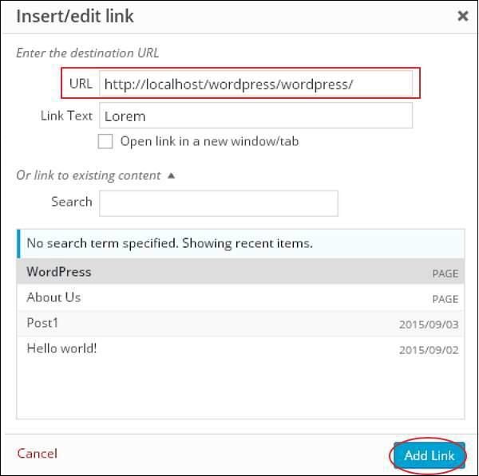
Wordpress-Add,Edit and Delete Links Link is a connection from one resource to another. Adding links to your pages or blog posts help you to connect to other pages.

Slide 29
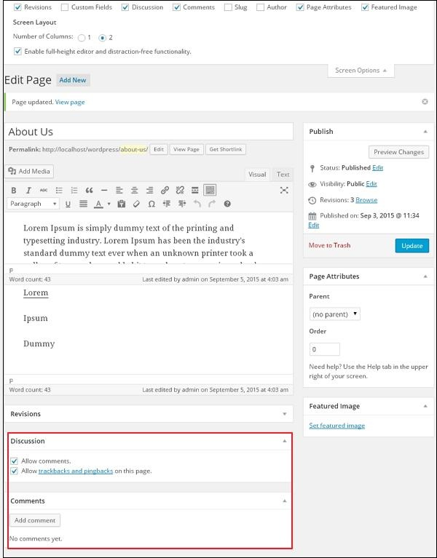
Wordpress-Add and Edit Comments Adding comments allows your visitors to have a discussion with you. Comments are approved by the admin and then posted to be discussed further.

Slide 30
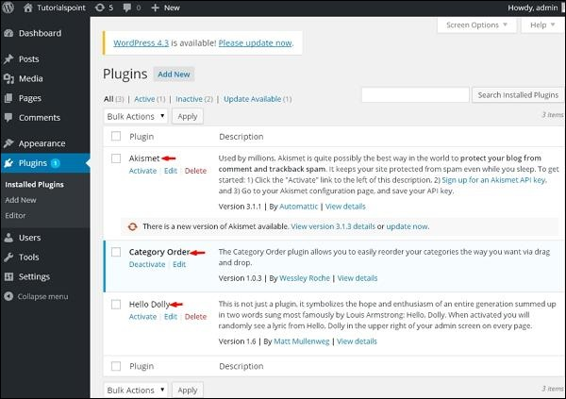
Wordpress-View and Install Plugin It helps you to enable and disable WordPress Plugins. This adds the unique features to an existing web site. Plugins extend and enlarge the functionality of WordPress.

Slide 31
WordPress - User Roles
Every user has their own role in WordPress. These roles can be allotted only by the Admin.
Here are few pre-defined roles available in WordPress −
Administrator
Editor
Author
Contributor
Follower
Viewer.

Slide 32
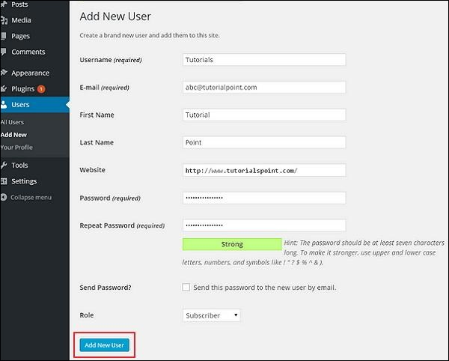
WordPress - Add Users

Slide 33
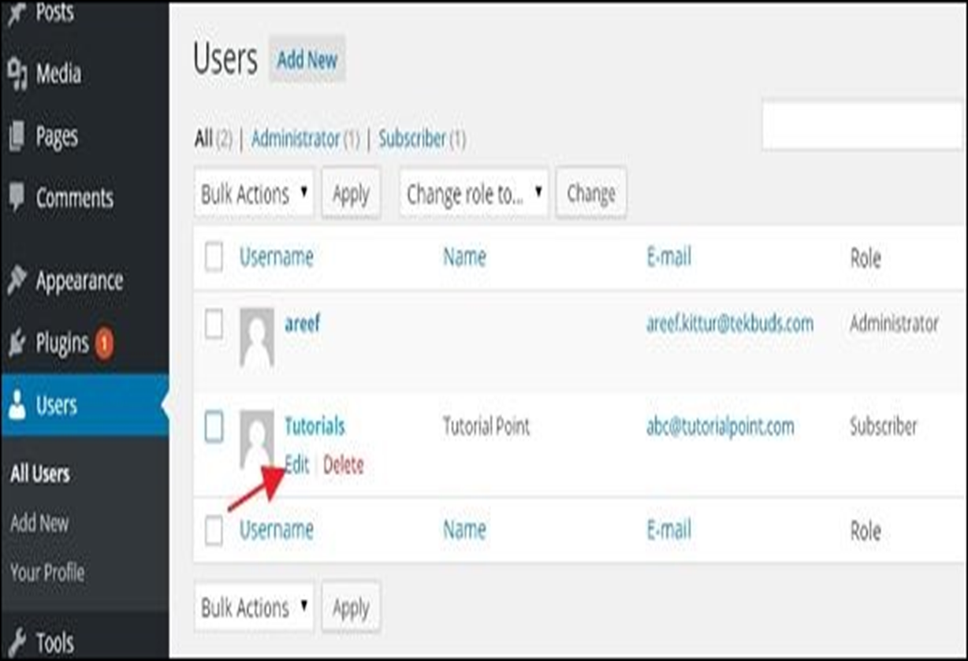
Wordpress-Edit and Delete Users

Slide 34
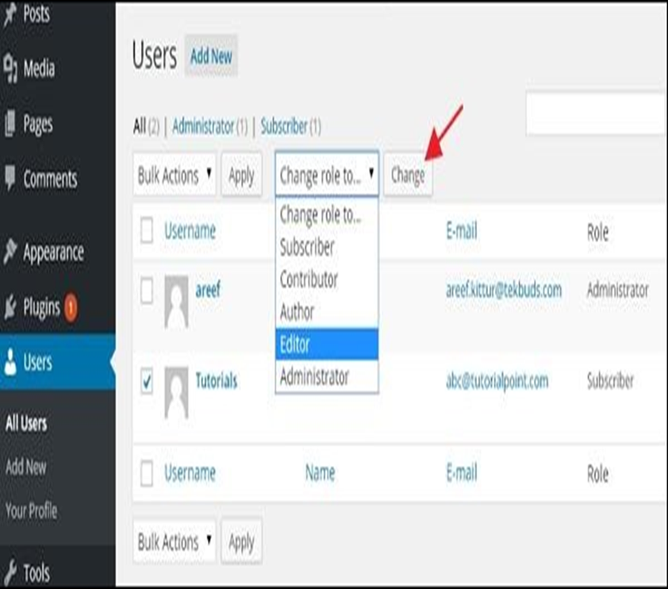
Change Role of Users

Slide 35
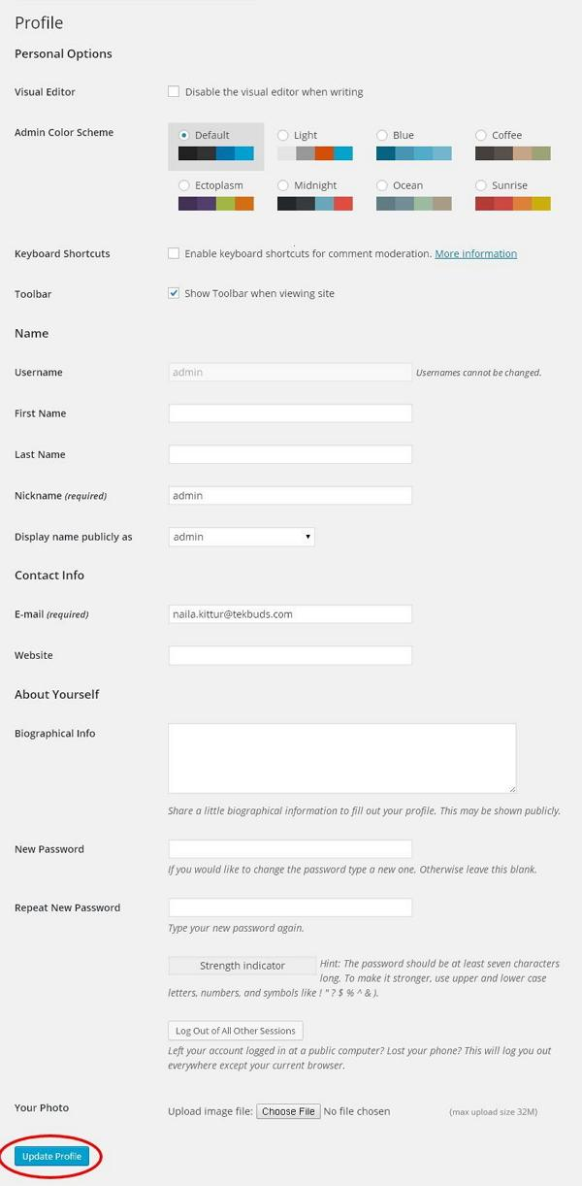
WordPress - Personal Profile

Slide 36
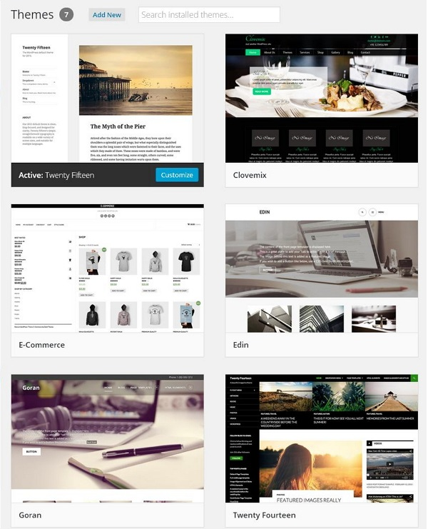
WordPress - Theme Management It includes image files, templates, CSS stylesheets, etc. that can help to make your website look great.

Slide 37
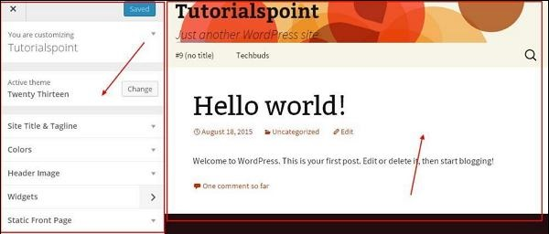
WordPress - Customize Theme

Slide 38
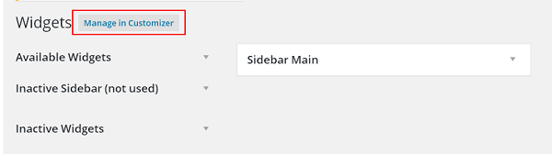
WordPress-Widget Management
Widgets are small blocks that perform specific functions. These give design and structure control to the WordPress theme.

Slide 39
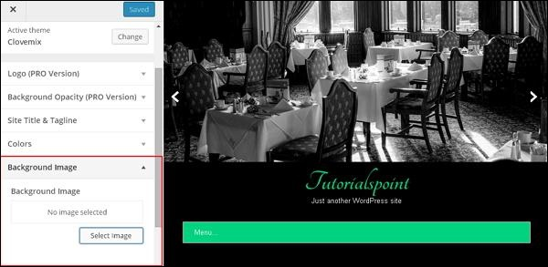
WordPress - Background

Slide 40
Wordpress-Advanced
Host Transfer
Version Update
Spam Protection
Backup & Restore
Optimization
Ensure high quality and meaningful content.
Have the right names for images.
Use short permalinks that contain keywords.
Have optimized themes.
Connect posts to social networks.
Delete your trash box.
Keep checking your plugins.
Use CSS and JavaScript effectively.

Slide 41
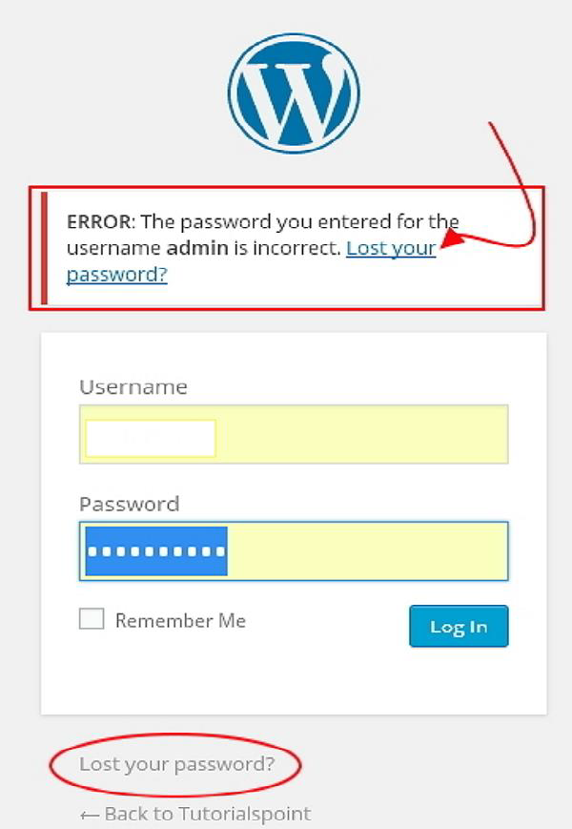
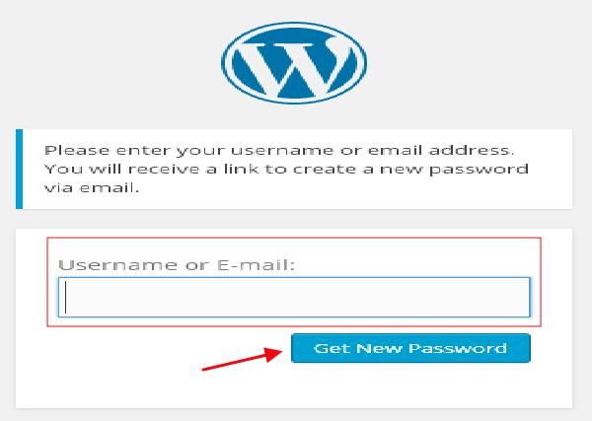
WordPress - Reset Password

Slide 42
Thanks

